Slide 1
Introductory Python
for engineering applications
Notes:
This is not a “Python 101” course. This is a crash course for Engineering students who have taken (or will take) MATLAB®. This seminar will get you started but is not a substitute for following the official Python tutorial.

Slide 2
Why I should learn Python
Aerospace: used extensively by NASA, including the Aviary and OpenMDAO frameworks
Mechatronics: ease of interfacing with hardware, processing sensor data, and controlling actuators makes it ideal for rapid prototyping
In demand: consistently ranked in the top three languages by GitHub and StackOverflow; the most popular language in the world according to PYPL
Cost effective: open-source and free to use for all (NO licensing fees)
as an engineering student
Notes:
Aviary is NASA’s “next gen” aircraft analysis, design, and optimization tool. GitHub is the world’s largest source code hosting provider. StackOverflow is the world’s most popular programming Q&A site (and where generative AI’s source most of their answers to programming questions). PYPL measures language popularity by examining Google Trends for language tutorials.

Slide 3
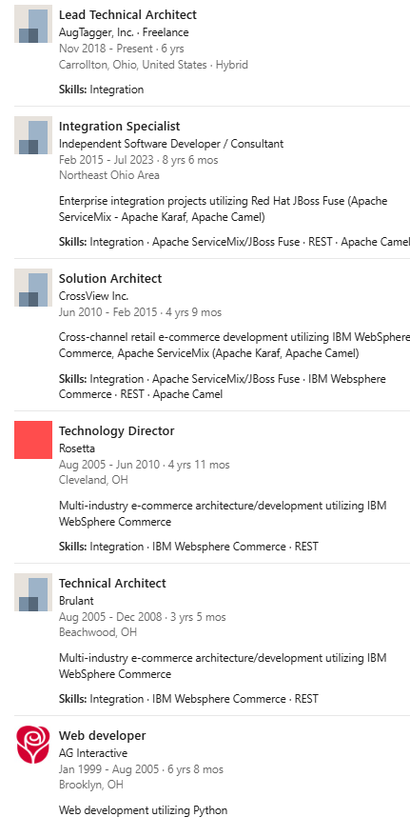
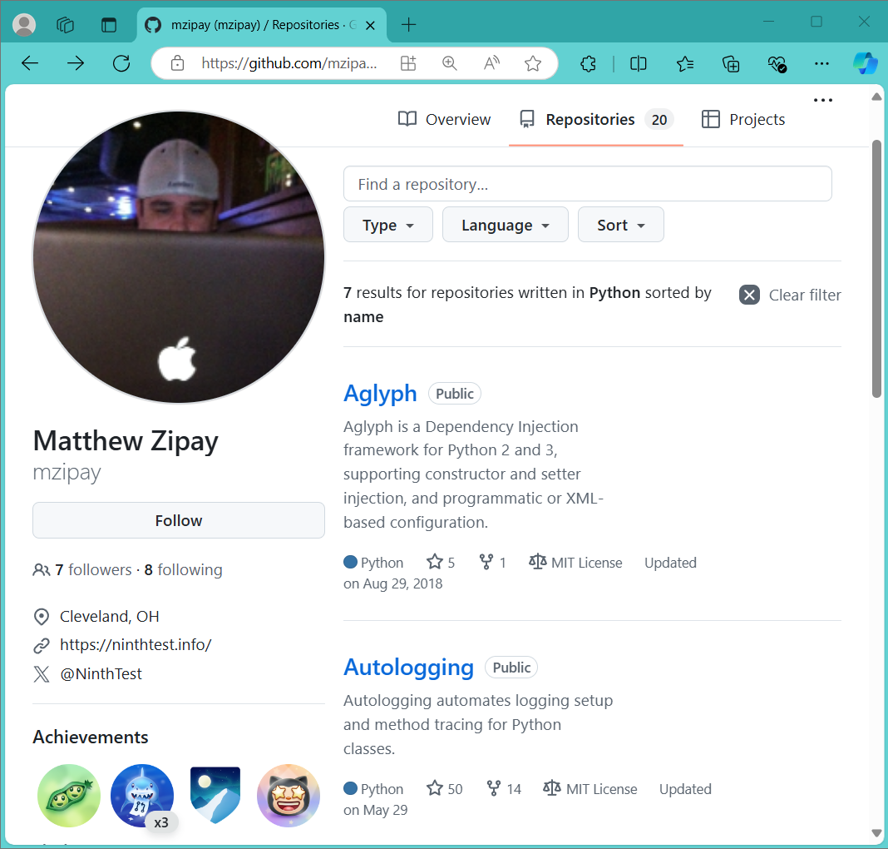
Why should I learn Python from this guy?
25 years of industry experience in software development
Open-Source author (Python, Java, JavaScript, C)

Slide 4

By the end of this seminar, you will be able to:
Prepare your development environment
Python interpreter
Git VCS (version control system)
Manage your Python projects
Python virtual environments and 3rd party libraries
Git project repository initialization
Translate MATLAB® to Python
Recognize syntax similarities and differences
Take advantage of the online documentation
Notes:
Terminology that may be new to some is italicized and in a darker font color.

Slide 5
Typing conventions
> python -m venv .venv --prompt env-name This is a PowerShell command. (Don’t be confused by “python” – in this context, that’s simply the name of the command we’re running in PowerShell.) DON’T type the > - that’s just the PowerShell prompt. DO type everything else, exactly as shown (including spaces, hyphens, etc.) >>> import numpy as np This is a Python statement. DON’T type the >>> - that’s just the Python prompt. DO type everything else, exactly as shown.
Notes:
The PowerShell command convention in particular will be used to introduce NEW commands as we encounter them.

Slide 6
This slide deck & all source files
https://tinyurl.com/ksu-aiaa-intro-py4engr
Notes:
The PowerShell command convention in particular will be used to introduce NEW commands as we encounter them.

Slide 7
Preparation
Download, install, and verify the Python interpreter.
Download, install, and verify the Git version control system.
Notes:
Step-by-step with screenshots for Windows. Mac users will have some extra steps (Brew).

Slide 8
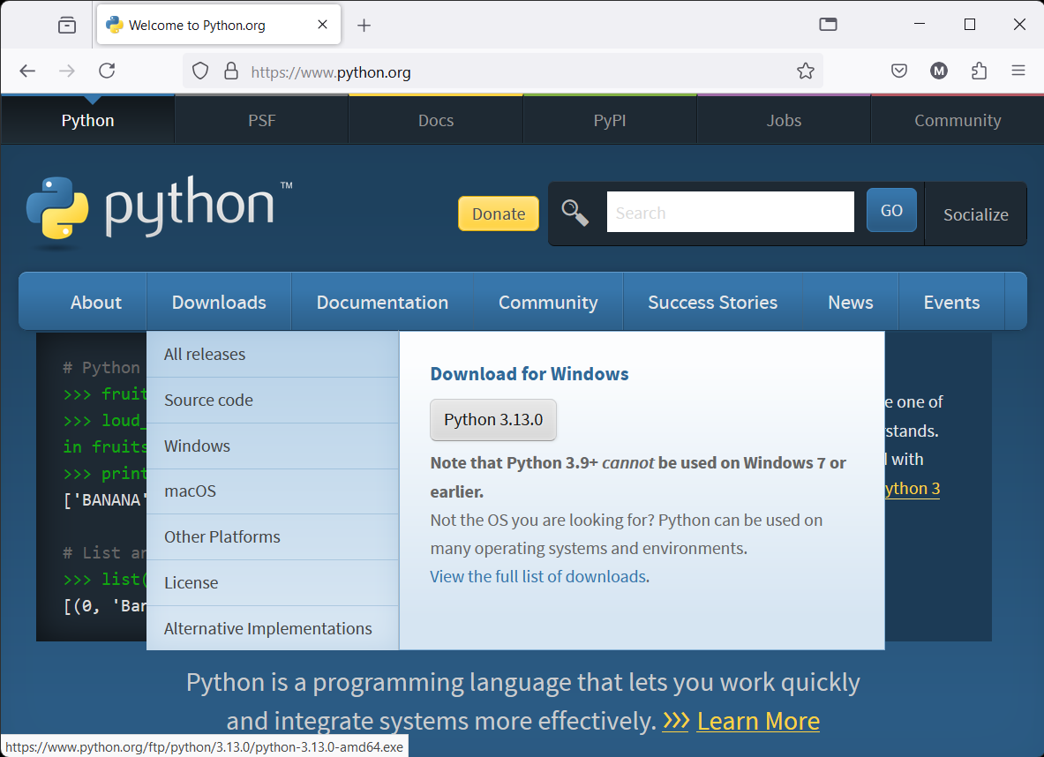
Download the current (“stable”) Python interpreter from https://python.org/.
Notes:
Hover over the [Downloads] menu. The correct download for your OS should be automatically selected. Run it once it has downloaded. “Do you want to allow this app to make changes to your device?” → [Yes].

Slide 9
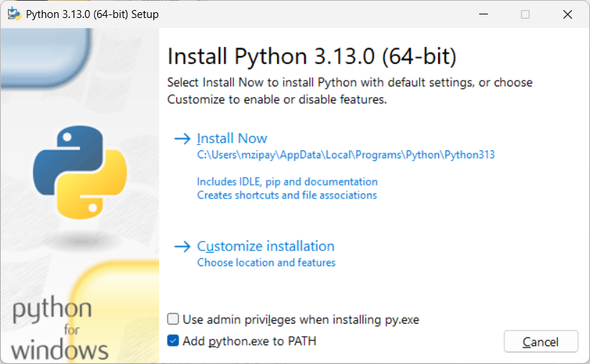
Be sure to check “Add python.exe to PATH” and then click “Install Now.”
Notes:
“Add python.exe to PATH” simple explanation: You can type “python” in any PowerShell or Cmd prompt to enter the Python interpreter or run a Python program.

Slide 10
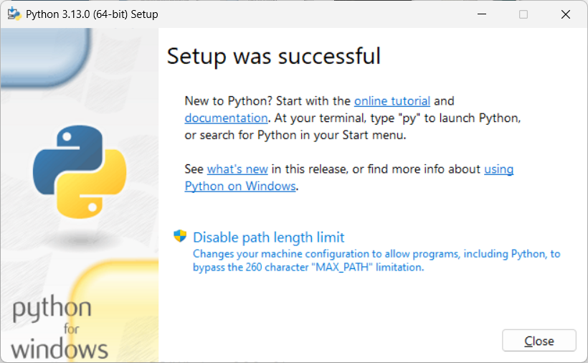
Click “Disable path length limit” and then grant permission (“Yes”) if asked.
Notes:
Disabling the path length limit is important to allow virtual environments to work properly. “Do you want to allow this app to make changes to your device?” → [Yes].

Slide 11
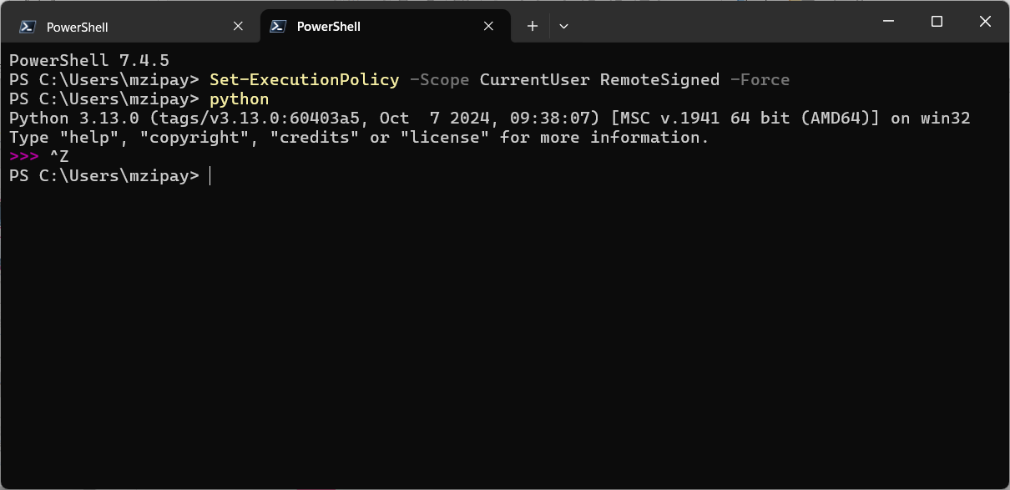
> Set-ExecutionPolicy -Scope CurrentUser RemoteSigned -Force > python >>> ^Z (i.e. [Ctrl]+[Z], then [Enter])
Notes:
The Set-ExecutionPolicy is only needed if running in PowerShell – look for the “PS” at the beginning of the line.

Slide 12
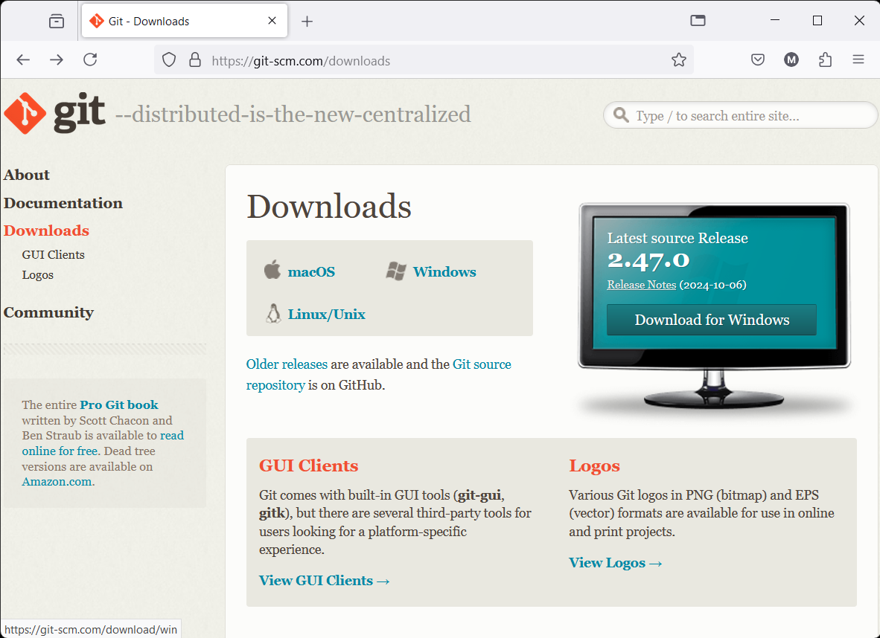
Download the current (“stable”) Git installer from https://git-scm.com/downloads.
Notes:
The correct download for your OS should be automatically selected. Run it once it has downloaded. “Do you want to allow this app to make changes to your device?” → [Yes]. Accept the terms & conditions.

Slide 13
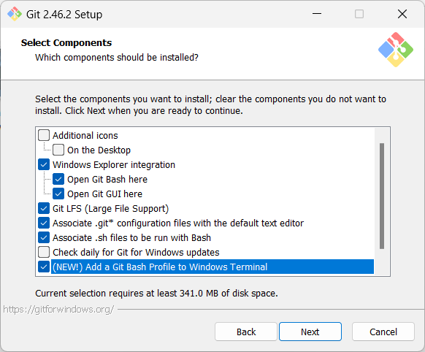
Continue accepting defaults & confirming (“Next”) as prompted. Exception: “Add a Git Bash Profile to Windows Terminal” is a really good idea.

Slide 14
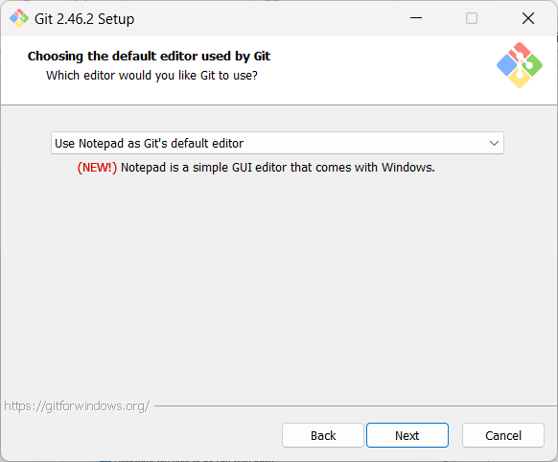
Unless you know Vim or really prefer a different editor, use Notepad.

Slide 15
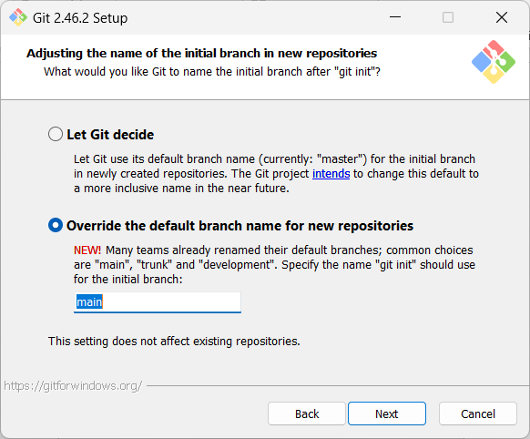
The modern de facto name for the default branch is “main.”

Slide 16
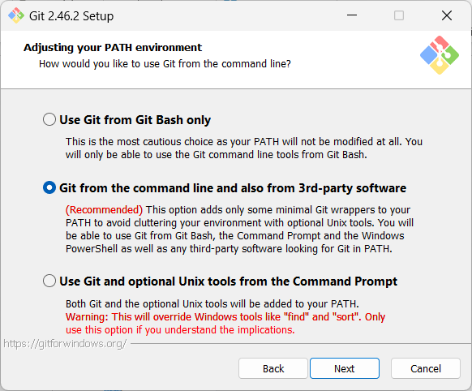
Accept the recommended option here, and all defaults for the rest of the install process. (You can safely uncheck the box at the end to view the release notes.)
Notes:
“Use Git from Git Bash only” is a more viable choice now that they’ve introduced the Windows Terminal profile (earlier step), but the recommended option here is still best for maximum interoperability.

Slide 17
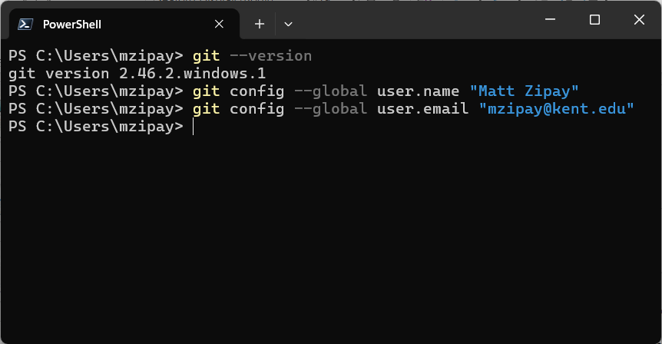
> git --version > git config --global user.name "Your Name" > git config --global user.email "you@kent.edu"
Notes:
Be sure to enter the commands exactly - note the positions of spaces, hyphens, quotes, etc. A commit is a source code change that you “finalize” by committing it to the repository so that it permanently** exists in the history of a source file.

Slide 18
ASIDE: Be careful when typing into or copying from any “non-plaintext” source!
Notes:
This is mostly relevant for Windows users, where apps like PowerPoint and Word automatically translate sequences of characters into non-ASCII glyphs. Show on-screen examples.

Slide 19
Management
Create your project and its virtual environment.
Install 3rd party libraries into your project virtual environment.
Initialize your project’s Git repository and make your first commit.

Slide 20
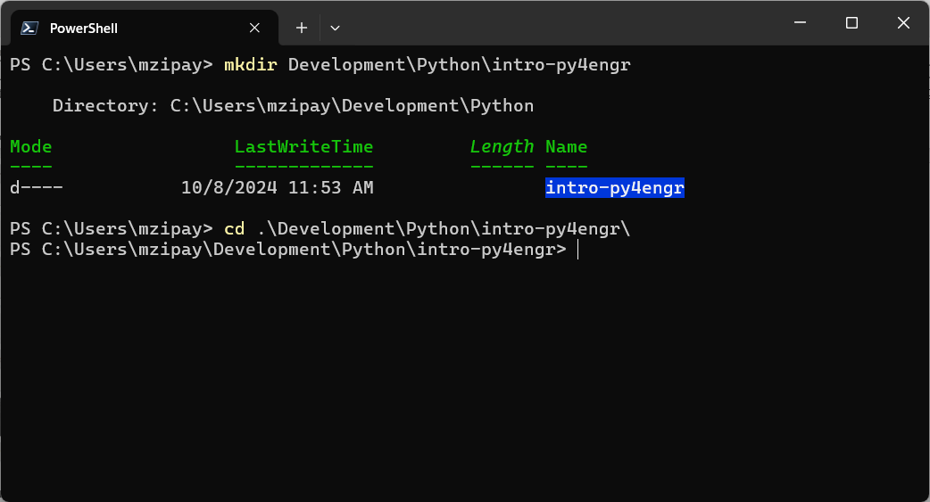
> mkdir Development\Python\intro-py4engr > cd Development\Python\intro-py4engr
Notes:
There’s nothing special about a project directory – it’s just a directory. Just make sure it’s NOT in a OneDrive directory (doesn’t play nicely with Git)! Best to put this directly under Don’t waste time keying in every single character in these commands – become accustomed to using tab completion.

Slide 21
ASIDE: Save time and minimize typing errors using “Tab completion.”
> cd D[Tab]
Notes:
Show [Ctrl]+{Space] “menu” completion also? (Don’t want to overload audience, but this is a nice feature.)

Slide 22
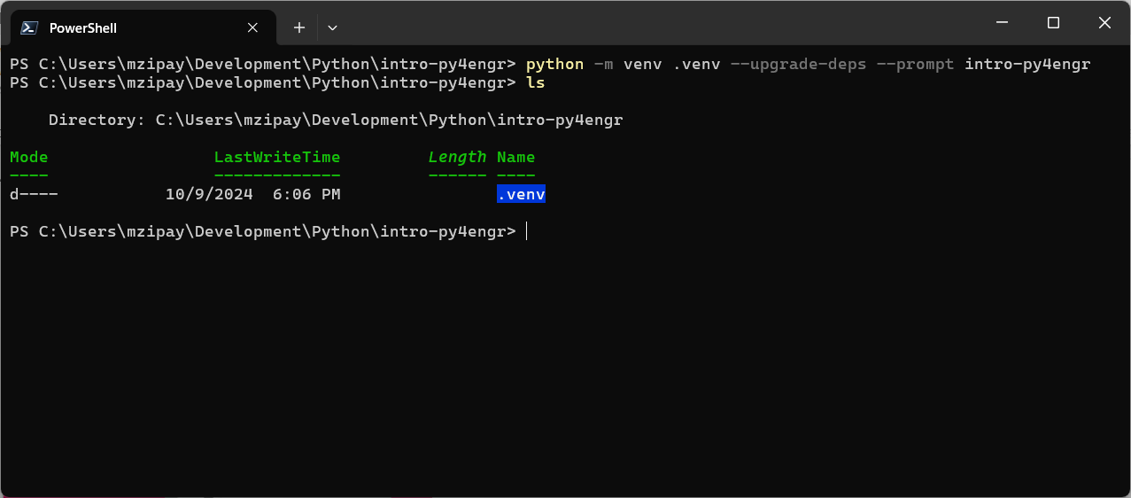
> python -m venv .venv --upgrade-deps --prompt intro-py4engr > ls
Notes:
Explain “python” = run the Python interpreter; “-m venv” = execute the venv module as a script; “.venv” = the name of the directory where the virtual environment should be created; “--upgrade-deps” = make sure all core dependencies in the virtual environment are up to date (pip); and “--prompt intro-py4engr” = have a useful prompt (instead of “(.venv)”) when the virtual environment is activated.

Slide 23
ASIDE: Virtual environments should be created in a .venv subdirectory and use --prompt to specify a meaningful name.
> python -m venv .venv --prompt "env-name"
Notes:
Benefits: max compatibility w/ tooling (like VS Code), easier to use a boilerplate .gitignore (covered later).

Slide 24
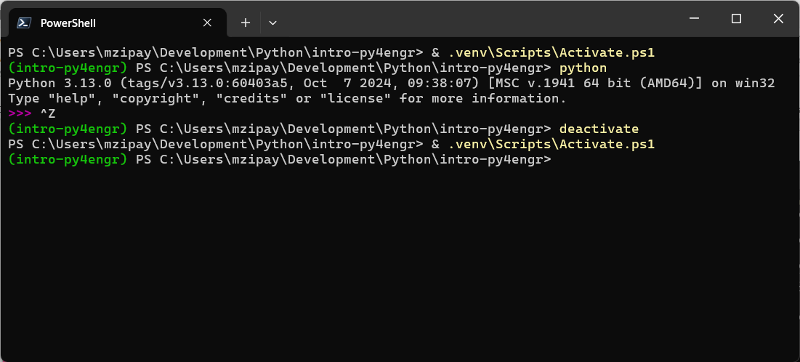
> & .venv\Scripts\Activate.ps1 > deactivate
Notes:
The ampersand (&) is an indication to PowerShell that you want to execute the named path component (Activate.ps1 in this case).

Slide 25
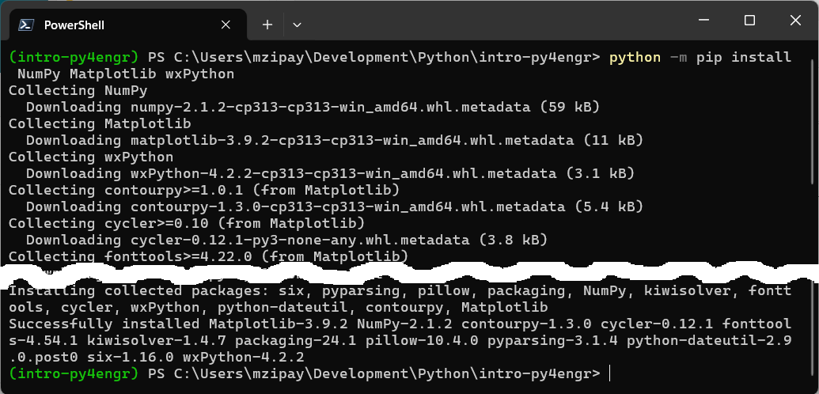
> python -m pip install NumPy Matplotlib wxPython
Notes:
Lots of output when running this command. Note: only need to name packages we want; all of their dependencies are handled automatically.

Slide 26
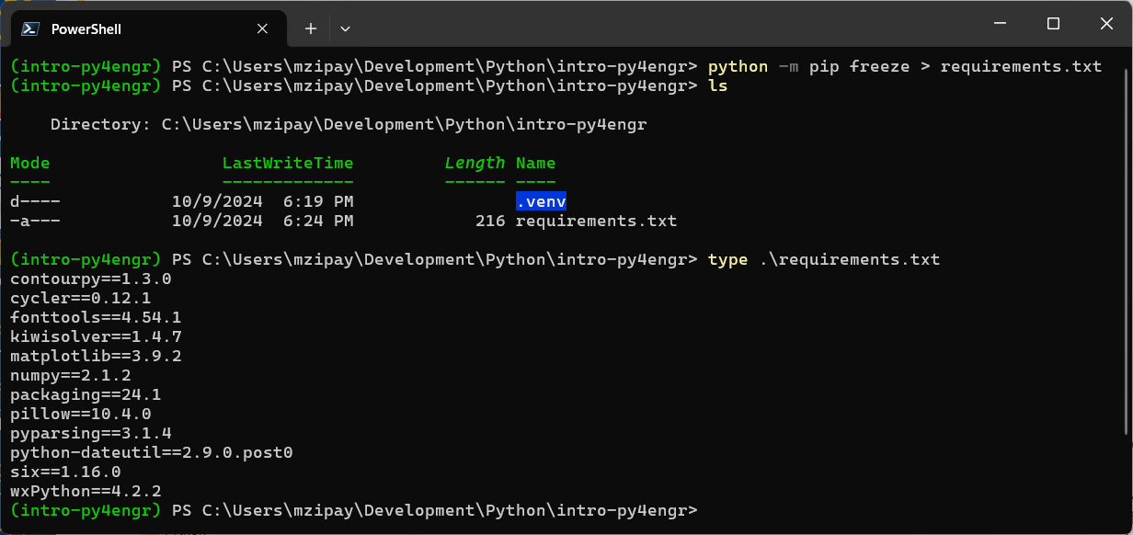
> python -m pip freeze > requirements.txt > ls > type requirements.txt
Notes:
The requirements.txt file explicitly defines the 3rd party libraries that we need for our project. More on this later.

Slide 27
ASIDE: Before we create the Git repository for our project, we need to understand the Git ignore (“.gitignore”) file.
(Live demo.)
Notes:
1) Open Windows explorer (or Finder on Mac). 2) Find your project folder. 3) DESTROY the entire “.venv” folder. Make it gone.

Slide 28
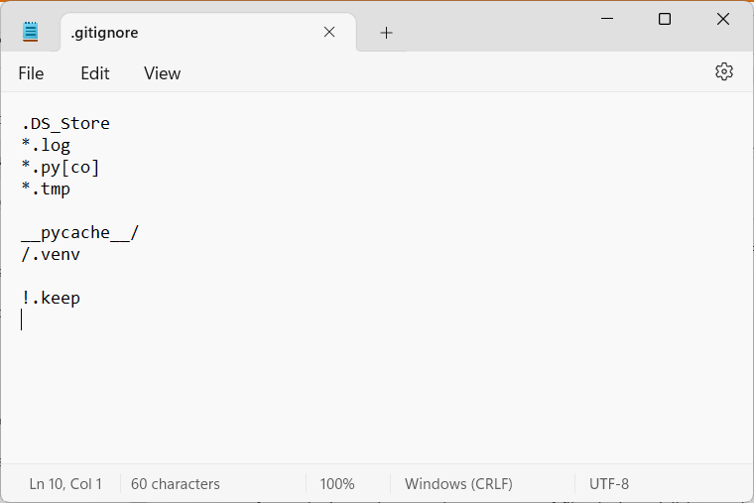
The filename here is exactly “.gitignore” (leading dot “.” and no file extension)! This file is located in your intro-py4engr directory.

Slide 29
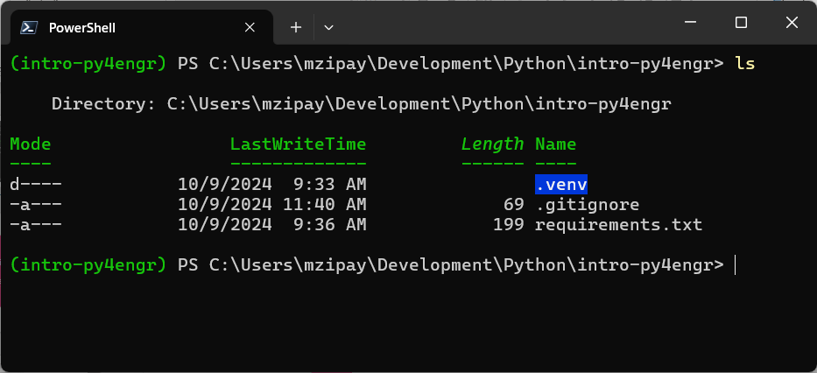
We’re finally ready to initialize our project’s Git repository.

Slide 30
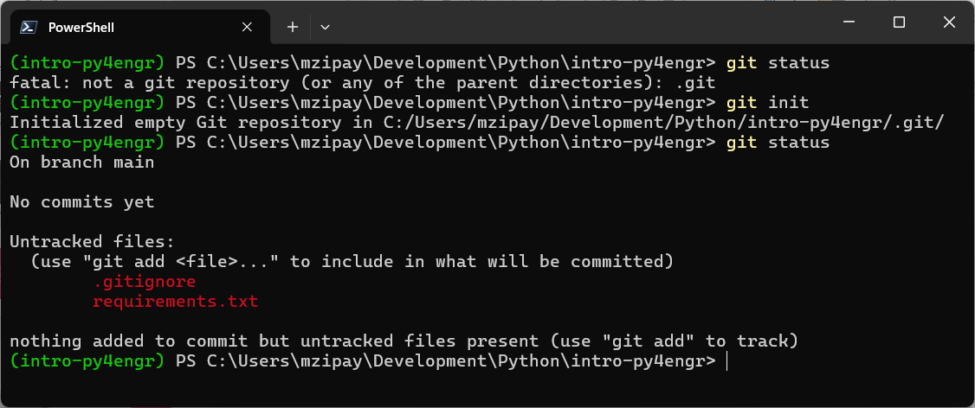
> git status > git init
Notes:
It is always safe to run “git status” – be liberal in your use of this command, especially since Git offers helpful guidance about what to do next!

Slide 31
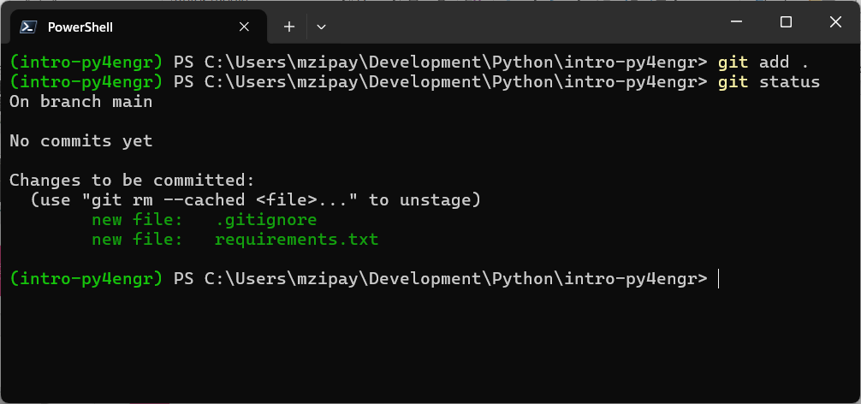
> git add . Notice that Git is reminding us that there are “No commits yet!”
Notes:
The dot “.” indicates that we want Git to add everything that it finds (that isn’t ignored, of course), recursively, beginning at the current directory. The dot “.” is shorthand for “current directory.”

Slide 32
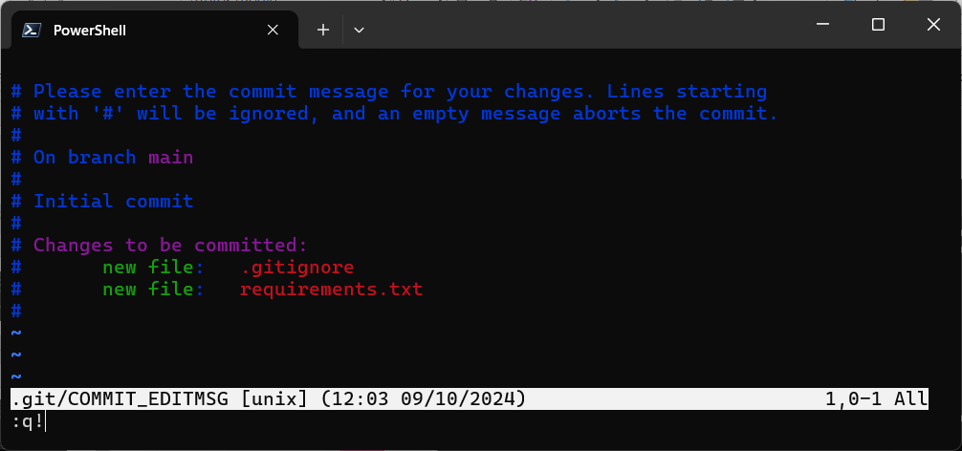
> git commit Again, notice Git’s helpful guidance/messaging.
Notes:
Will look different for most since I’m set up to use the Vim text editor, but we specified Notepad during Git installation.

Slide 33
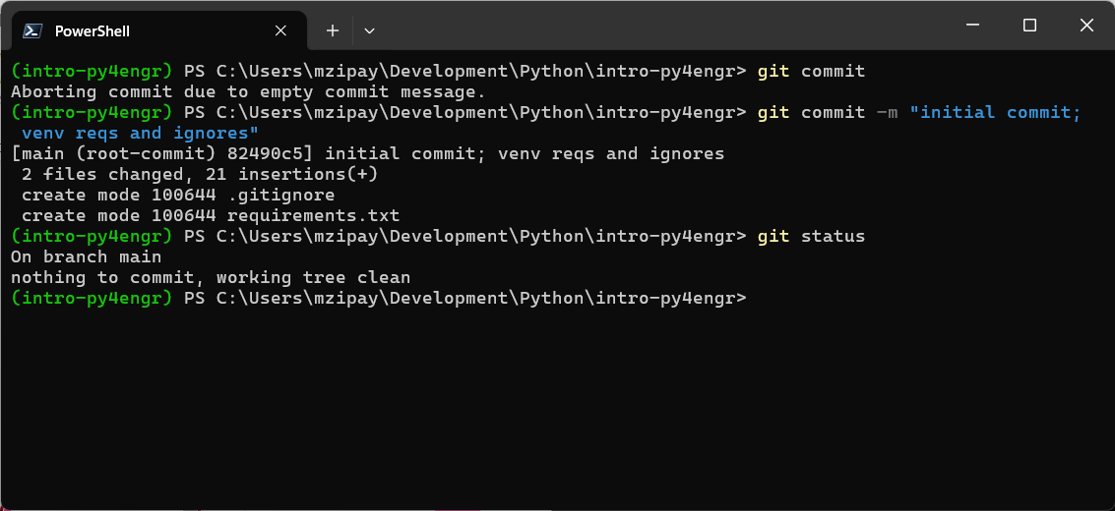
> git commit -m “initial commit; venv reqs and ignores” Commit messages should be concise – a short phrase summarizing the change.

Slide 34
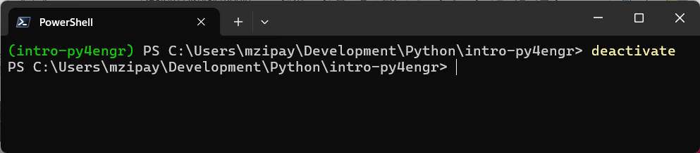
ASIDE: Virtual environments are meant to be easily re-creatable.
> deactivate (Audience exercise!)
Notes:
1) Open Windows explorer (or Finder on Mac). 2) Find your project folder. 3) DESTROY the entire “.venv” folder. Make it gone.

Slide 35
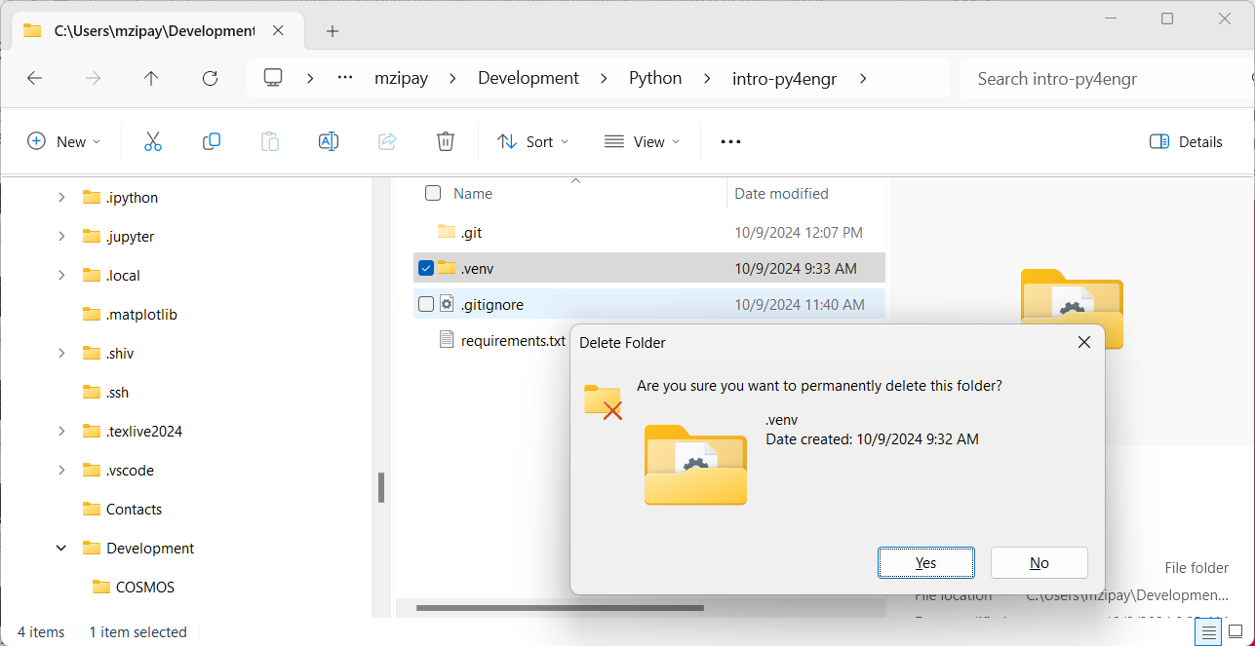
Oh nooooooooooooooooooooes!!!
Notes:
1) Open Windows explorer (or Finder on Mac). 2) Find your project folder. 3) DESTROY the entire “.venv” folder. Make it gone. POP QUIZ: How do we recreate the virtual environment?

Slide 36
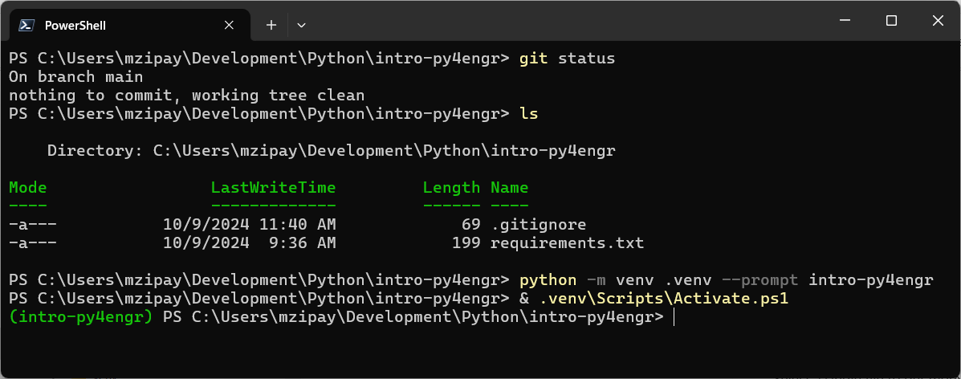
Are we finished re-creating the virtual environment?

Slide 37
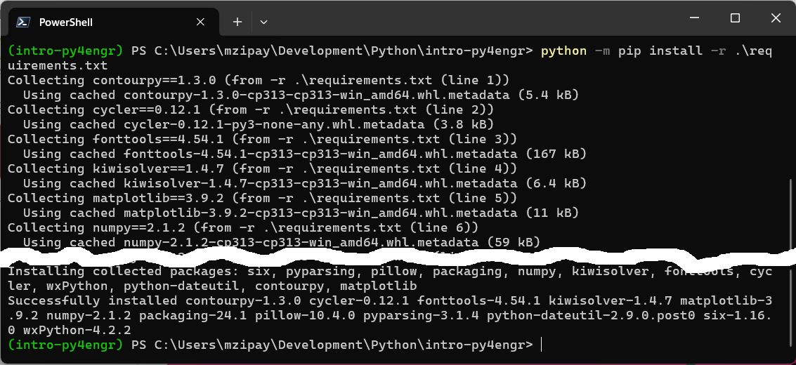
> python -m pip install -r requirements.txt
Notes:
This is why we create a requirements.txt file – so that we can reproduce our environment exactly.

Slide 38
Translation
Write MATLAB®-equivalent Python code using the standard math library & the numpy and matplotlib 3rd party libraries.

Slide 39
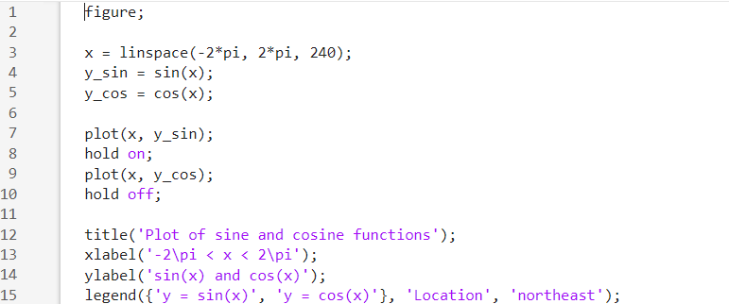
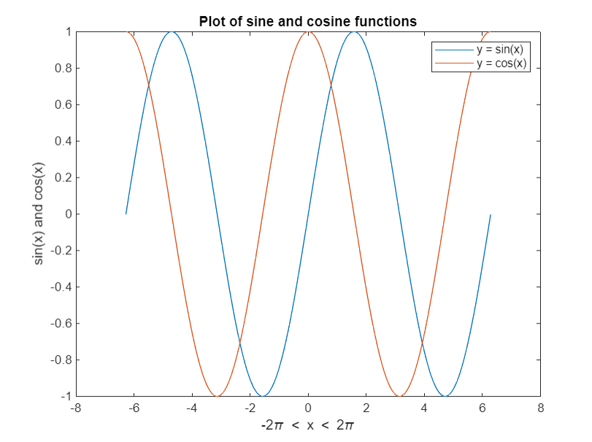
A simple MATLAB® plot.
How can we create the
same plot using Python?

Slide 40
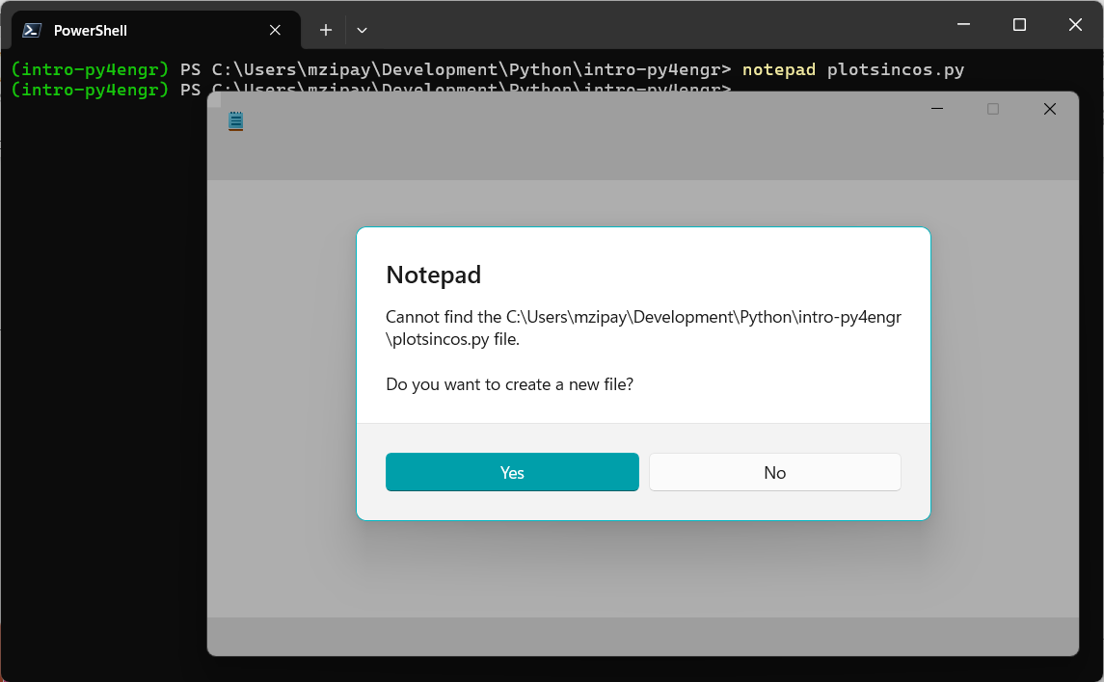
Create the plotsincos.py source file in your project directory.

Slide 41
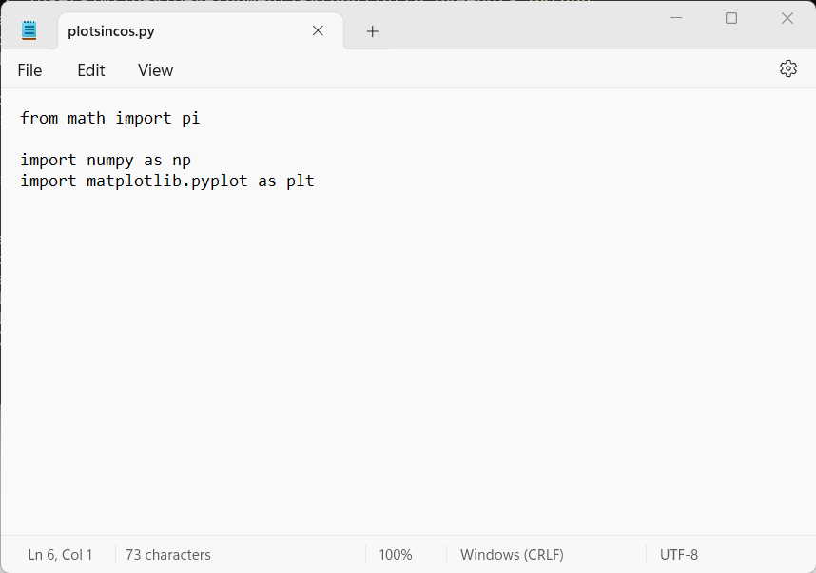
1. Import the modules and constants we need
Notes:
Remember that Python is a general-purpose language – we need to specify (import) what we intend to use. These are the conventions for numpy and matplotlib imports. We know we need numpy for the numerical processing, and since we’re creating a plot that mimics MATLAB we of course need matplotlib as well.

Slide 42
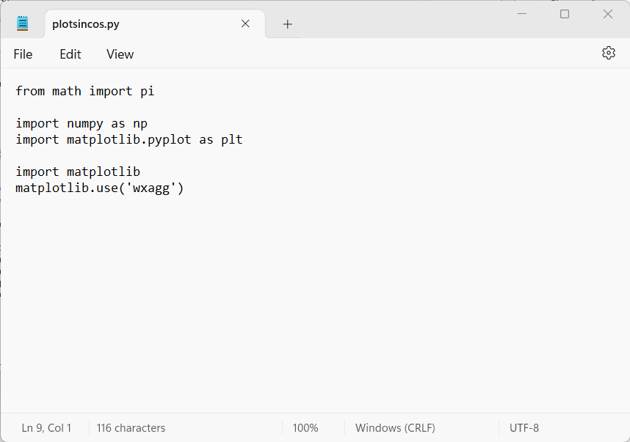


2. Use a cross-platform matplotlib “backend”
Notes:
This is important for two reasons: (1) it ensures that anyone can use our project (Windows, Mac, Linux) and (2) it allows matplotlib to work in a virtual environment (historically this has been problematic; using a library like wxPython is one workaround).

Slide 43
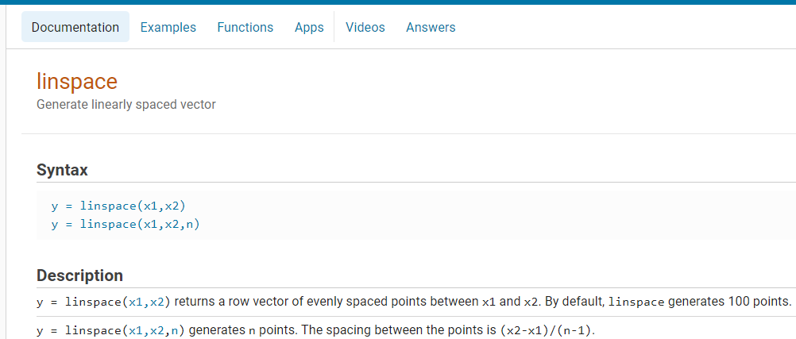
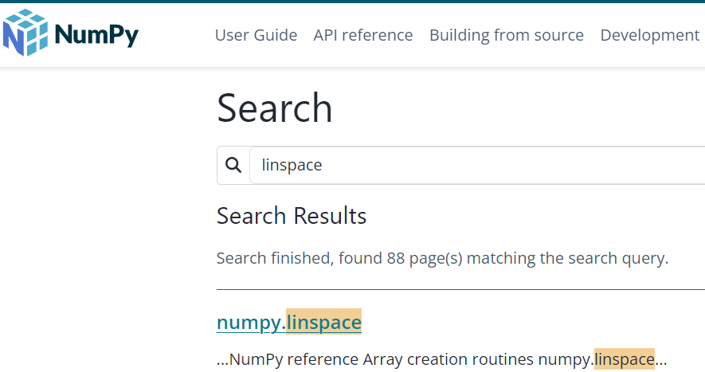
3. Discover the numpy equivalent of MATLAB® linspace
Notes:
We got lucky here – there’s a direct equivalent. That may not always be the case, so it’s important to read both the MATLAB and Python/NumPy/Matplotlib documentation to fully understand the similarities and differences.

Slide 44
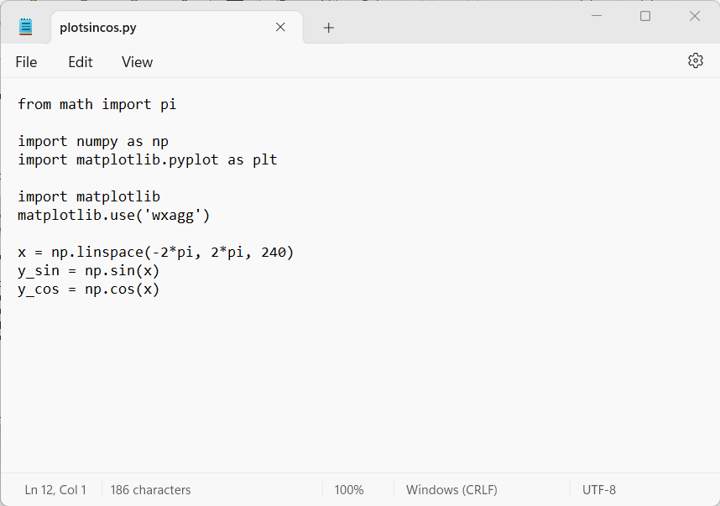



4. Define our independent and dependent variables
Notes:
This example shows how similar MATLAB and Python can be.

Slide 45
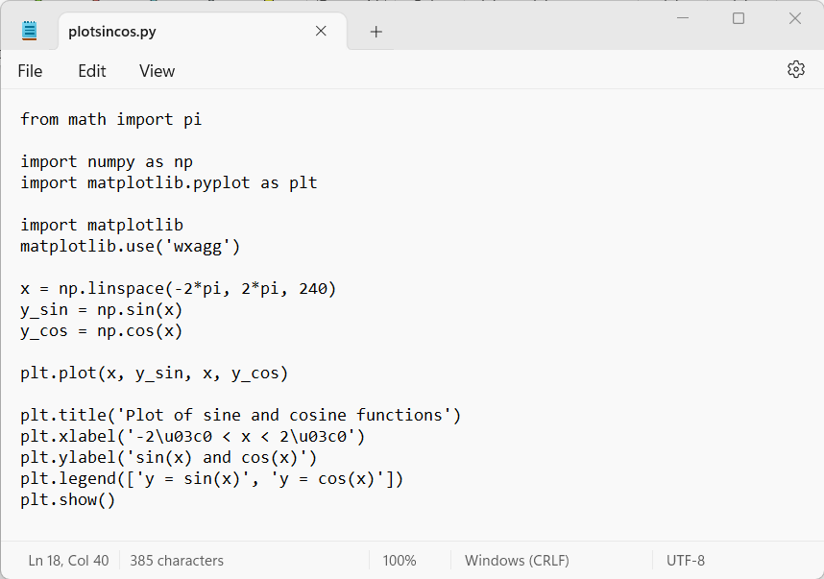





5. Plot our functions and display the figure

Slide 46
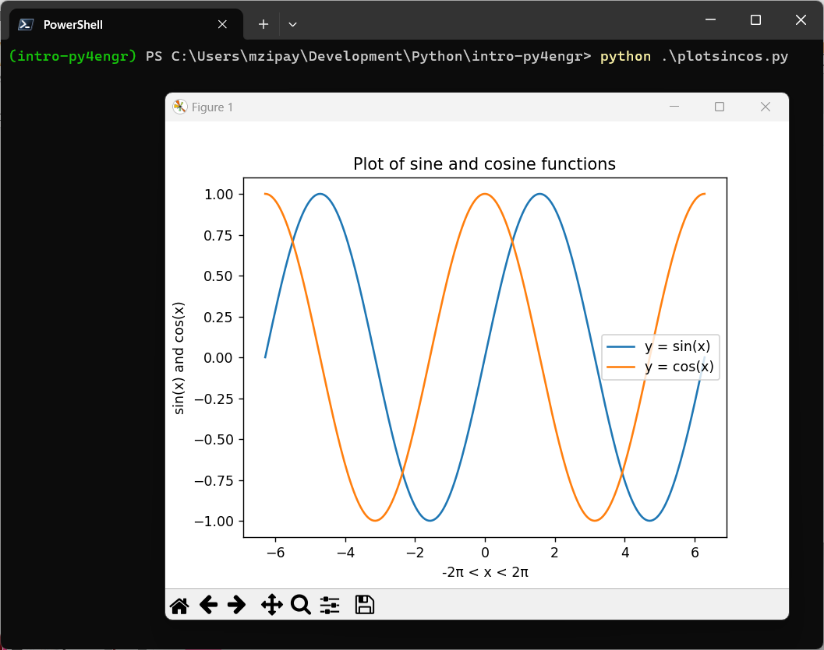
> python plotsincos.py

Slide 47
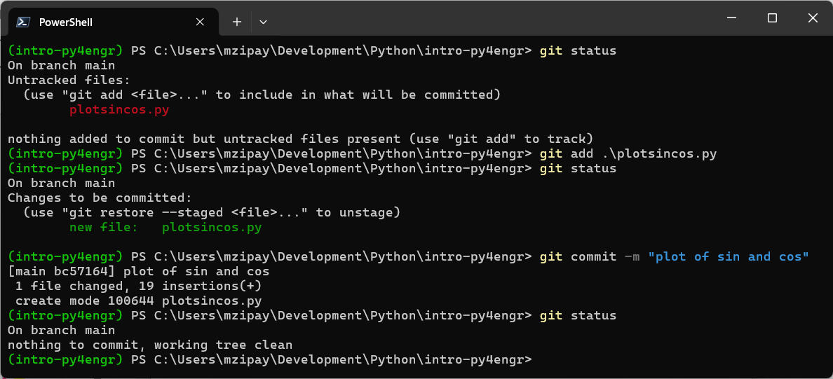
> git add plotsincos.py > git commit -m "plot of sin and cos"

Slide 48
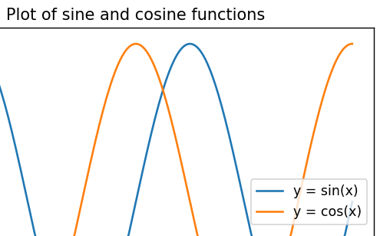
We forgot something.
In the original MATLAB® plot, we configured the legend to appear in “northeast” corner of the figure. But our Python figure has the legend centered vertically along the east edge. Let’s fix that…

Slide 49
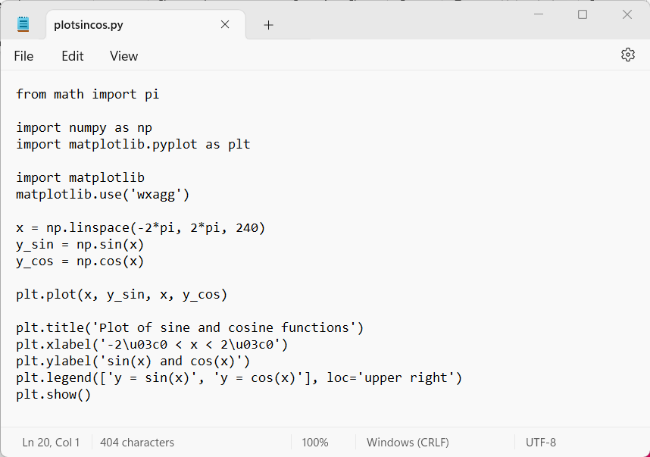

6. Fix the location of the figure legend
https://matplotlib.org/stable/users/explain/axes/legend_guide.html#legend-location
Notes:
Here’s a case where the Python matplotlib code is NOT the same as the MATLAB code. We need to read the documentation to understand how to configure the location of the legend.

Slide 50
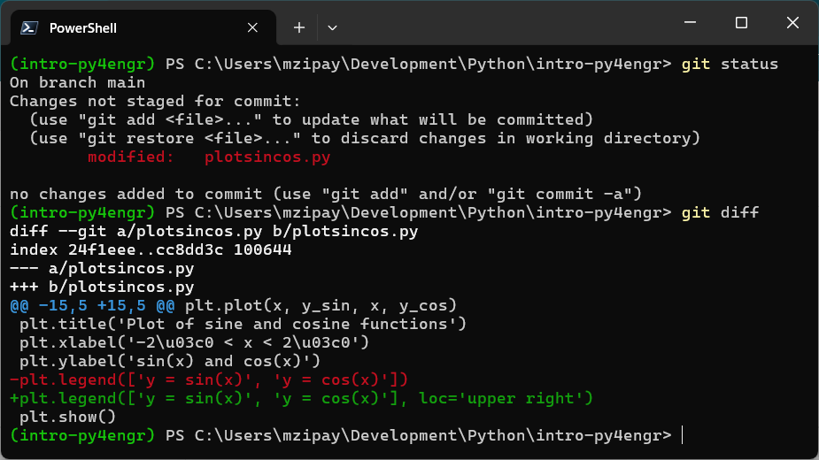
> git diff
Notes:
Learning to read diffs (there are several different formats) is a skill that takes a bit of practice. Fortunately, Git provides helpful feedback by way of color-coding.

Slide 51
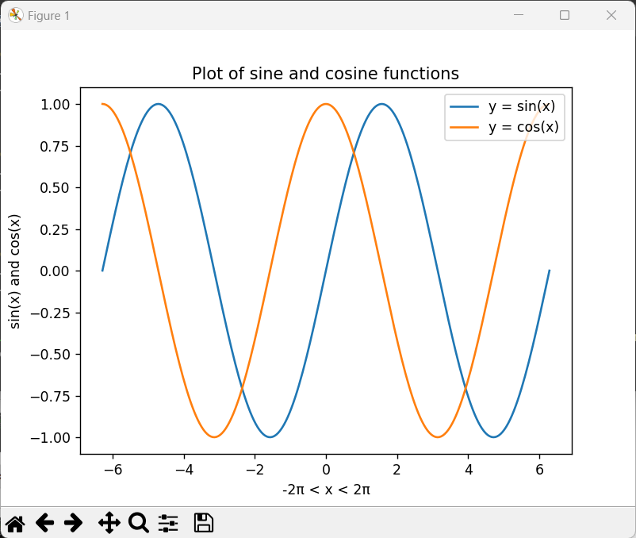


> python plotsincos.py Take two.

Slide 52
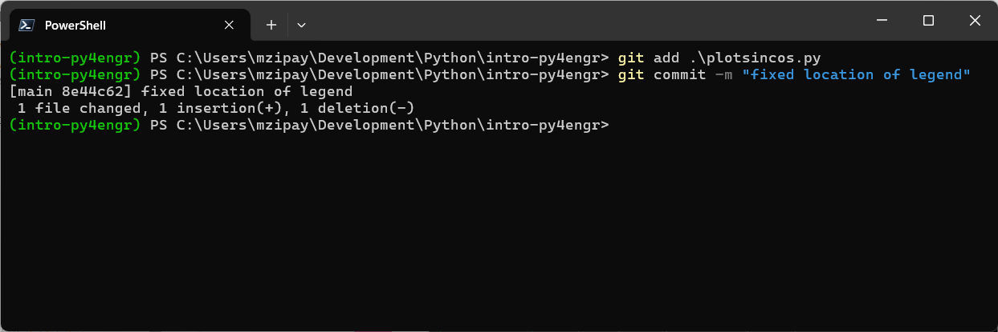
> git add plotsincos.py > git commit -m "fixed location of legend"
Notes:
Nothing new here.

Slide 53
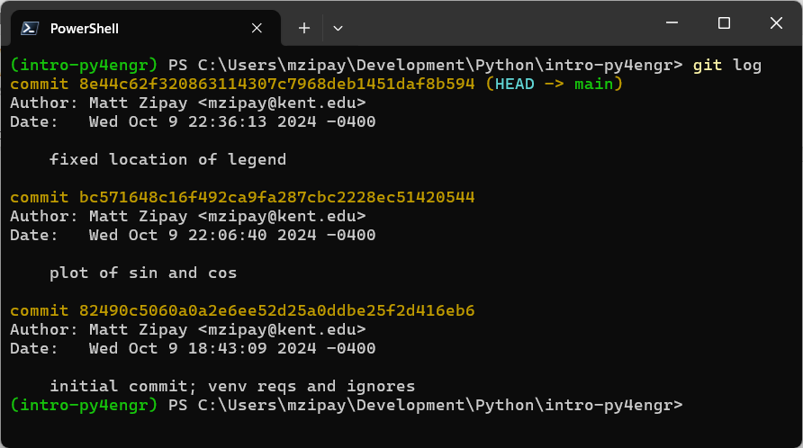
> git log
Notes:
Git log provides a chronological view of all commits (not just yours).

Slide 54
I committed a change by mistake. Can I “undo” that commit?
Once a change has been committed, it is part of history.
There is no explicit “undo” for a commit, but you can undo the change(s) from a commit.

Slide 55
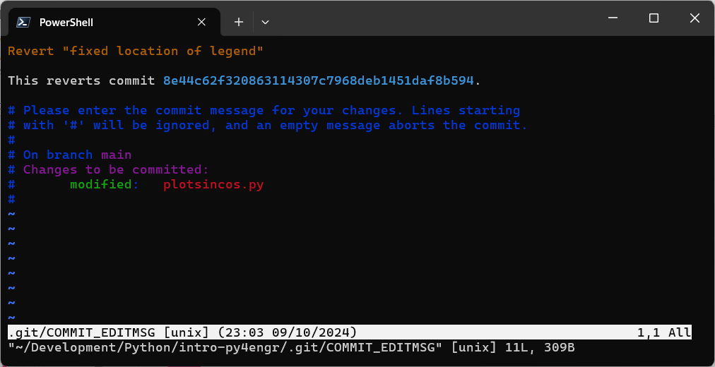
> git revert 8e44c62
Notes:
Reverting a commit creates a NEW commit that undoes the change(s) from the commit you’re reverting. That’s not confusing at all ;)

Slide 56
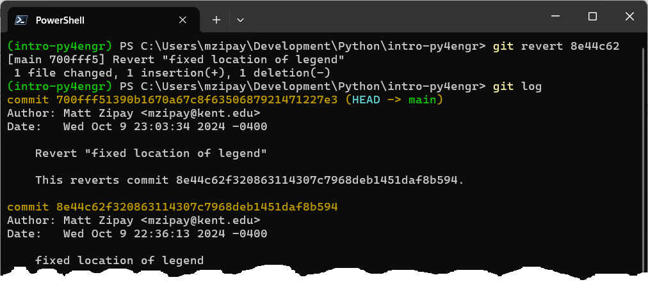
> git log
Notes:
Notice the new commit.

Slide 57
I accidentally added (and committed) a file that should be ignored. How can I “remove” it from Git?
It happens more often than you might think.
Fortunately, we can fix this in two steps.

Slide 58
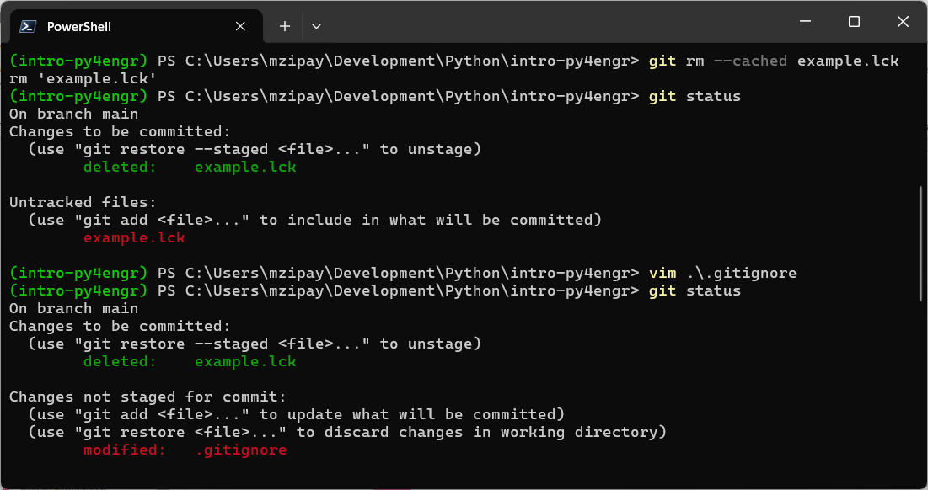
> git rm --cached example.lck Now add “example.lck” (or “*.lck”) to the .gitignore file (then add & commit). > git add .gitignore > git commit -m "now ignoring lock files"
Notes:
The point here (and how this differs from a revert) is that we don’t want to delete the physical file. It’s important in some way – we just don’t want it tracked in Git.

Slide 59
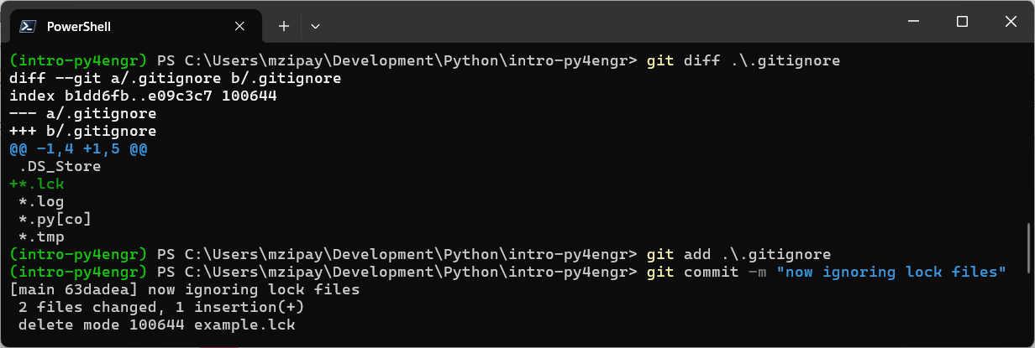
> git rm --cached example.lck Now add “example.lck” (or “*.lck”) to the .gitignore file (then add & commit). > git add .gitignore > git commit -m "now ignoring lock files"

Slide 60
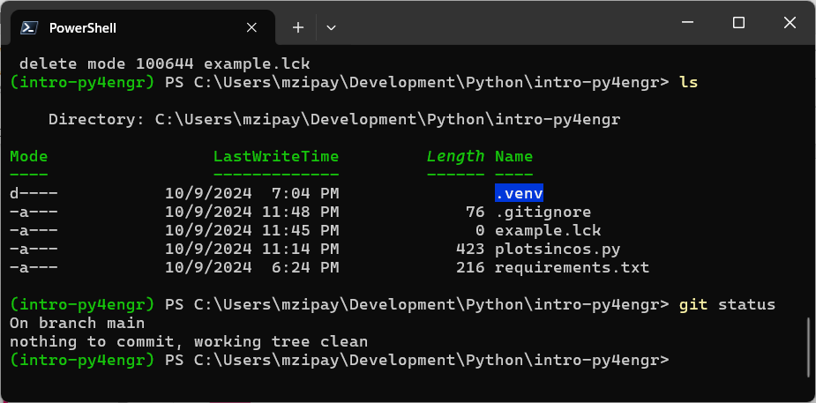
> git rm --cached example.lck Now add “example.lck” (or “*.lck”) to the .gitignore file (then add & commit). > git add .gitignore > git commit -m "now ignoring lock files"
Notes:
Notice that the file is still physically present, but git status reports “nothing to commit, working tree clean.”

Slide 61
I committed a mistake that should not exist in the history at all. Really. Reverting the commit is not sufficient.
If you insist…
(But this is really not something you should do often. You have been warned!)

Slide 62
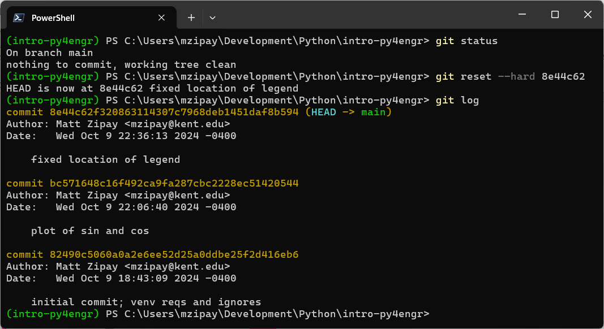
> git status > git reset --hard 8e44c62 > git log
Notes:
The “reset --hard“ command is DESTRUCTIVE – it will destroy recorded history. ALWAYS run git status first to make sure you’re not losing anything important!

Slide 63
Today I learned
How to prepare my Python + Git development environment
How to manage my projects’ virtual environments and Git repositories
How to use online documentation to translate my MATLAB® code into Python code

Slide 64
Further studies in Python & Git
The Python Tutorial
The Python Tutorial – Mathematics
NumPy – Learn
Using Matplotlib
Git – Documentation (includes link to free “Pro Git” e-book)
MATLAB Documentation
More interesting links
PowerShell Documentation
MATLAB Online Versions
MATLAB vs. Python
Python perspective: Why and How to Make the Switch
MATLAB perspective: Which One Is Right for You?
3rd party perspective
The ZIP archive of this slide deck and all source code files
This slide deck and all source code files available on GitHub at KSU-AIAA/intro-py4engr

